Slide 1
Communicating Climate Change Exploring the data behind the temperature rise
Group 1 - Reaktor
Kucheria Aayush
Nguyen Khue
Niva Verna
My Bui
Sauer Hanne
Wojnicki Mikolaj

Slide 2
Background
Climate change, mainly due to carbon dioxide (CO2) and methane emissions, is one of the largest challenges that humanity is currently facing.
As greenhouse gas emissions are distributed globally and over a wide range of societal activities, it needs to be addressed from a global point of view.

Slide 3
Goal
To communicate climate change in a visual and effective way
To a predominantly Nordic audience
And disclose what explains the ongoing emission in different parts of the world

Slide 4
Data Sources
Mostly CO2 emissions data
Key data source: Our world in Data
Collection of data from multiple sources
In a cohesive and accessible format allowing automatic updates to the website
Temperature data from GISS

Slide 5
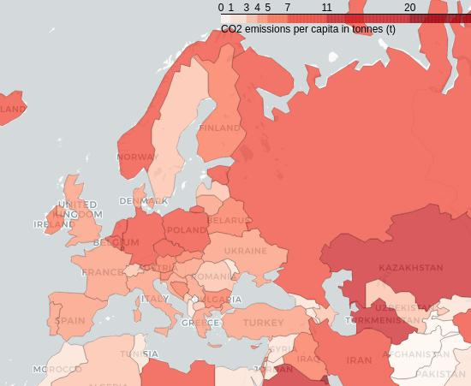
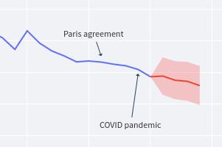
Methods
01
02
Website with plenty of interactive visualizations that tell the story
Emission predictions made using multivariate linear regression

Slide 6
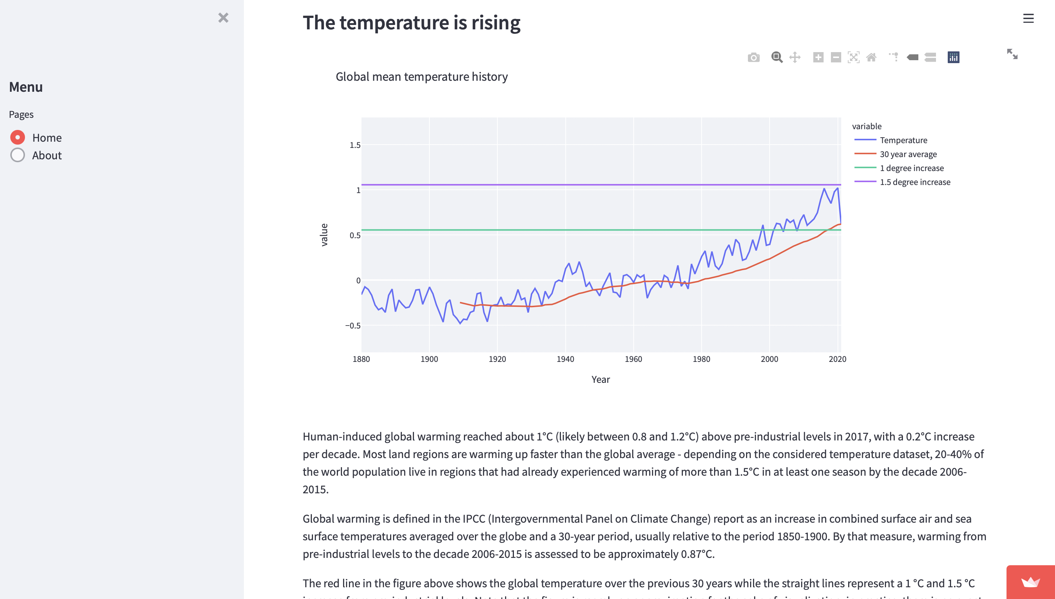
Demo of the Website
Interactive website
Answers what, where and why
As well as what can be done
Opportunity to deep dive into the Nordics

Slide 7
Ethical issues
01
02
Overall ethical issues regarding climate change
Ethical issues regarding the approach of this project
Nature of impacts are indirect
Responsibility hard to determine
Impacting those most who are not responsible for the emissions (Developing countries, the lower classes, nature and animals
Duties of developed nations to developing countries
Data related issues cumulate to method related issues
There are observation gaps in the data on aspects of climate change
Observation gaps include gaps regarding certain geographical areas of the world, in particular the climate data in southern countries and continents which are already struggling with the effects of climate change and fighting it

Slide 8
Future prospects
01
Automatic updates
The website will continue to update itself automatically when new data is updated in Our World in Data
The following years will show how strong the increasing momentum of decreasing emissions will be, which will make it considerably easier to predict future emissions. It will also relieve what the factors are that help decrease emissions the most, but also what features those countries have.
02
Increasingly complex models
Models such as polynomial regression and time series autoregressive model - to capture the nonlinearities in the data more accurately
03
Gears-level understanding
To understand the explanatory variables and preprocess them more effectively
04
Highlight notable events
Both climate related and non to explore the potential non-trivial impact on emissions

Slide 9
Thank you!

Slide 10
Back-up
Communication
The main communication channel for the group will be Telegram. In addition, weekly meetings will be held on Google Meets on Wednesdays. As for communication with Reaktor, the main communication will happen via email. The aim is that Reaktor will join the team during the autumn frequently.
Practices
Google Drive and GitHub will be used for the code and sharing documents like notes, but also data. In addition, the team is looking into the option of using a database for storing the data. The predominantly time-series or relation data will be in csv and xlsx format. Google Colab will be used as the computing environment
Our ways of working
1. Step
2. Step
3. Step
Each group member will investigate a data source and go through the data keeping the usage of it mind
On Wednesday the 29th of September, the group will go through the findings of each team member
Then the data will be preprocessed and cleaned if and when need.

